Slide 2
rdt_rcv(rcvpkt)&& notcorrupt(rcvpkt)
If (rcv_base<=rcv pktnum< =rcv_base+N-1) {
if (rcvdpktnum== rcv_base)
{
for(i=rcv_base,i<leastunackpktnum,i++){
extract(rcvpkt(i),data)
deliver_data(data)
}
sndpkt=make_pkt(rcv_base,ACK,checksum)
udt_send(sndpkt)
rcv_base= least unack pktnum
}
elseif (rcv_base not acked yet)
{
buffer(rcvpkt)
sndpkt=make_pkt(pktnum,ACK,checksum)
udt_send(sndpkt)
}
elseif(rcv_base-N<=rcv pktnum<= rcv_base-1)
{ sndpkt=make_pkt(rcvpktnum,ACK,checksum)
udt_send(sndpkt)
}
wait
Λ
Expected seqnum=1
snd_pkt=make_pkt(0,ack,checksum)

Slide 3
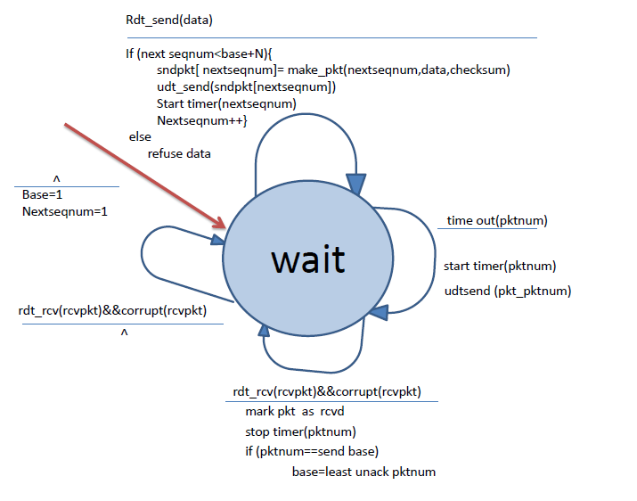
Not corrupt(rcvpkt)

